Slide 1
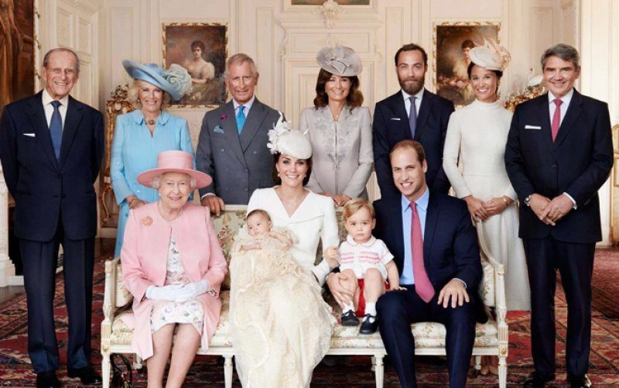
The British Royal Family

Slide 2
Being a member of the Royal Family => Making personal sacrifices

Slide 3
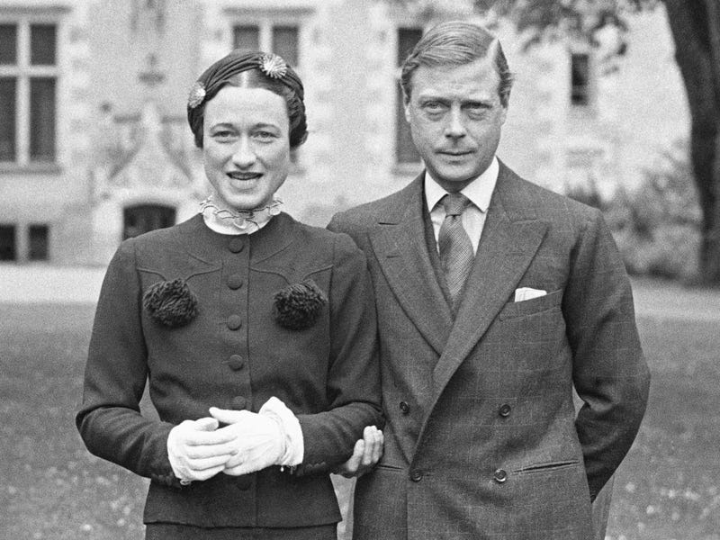
Wallis Simpson and Edward VIII

Slide 4
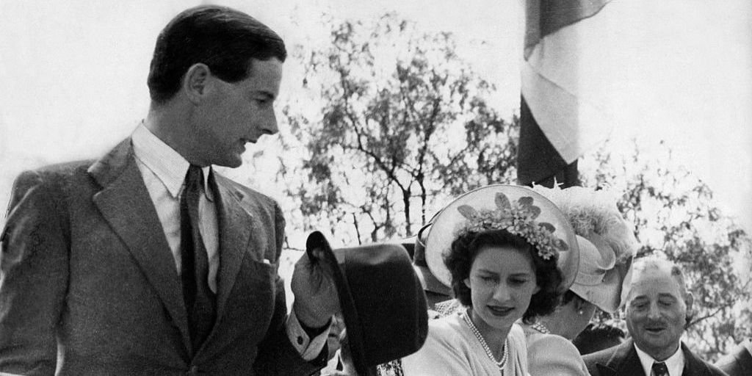
Captain Peter Townsend and Princess Margaret

Slide 5
Being a member of the Royal Family => Having no individuality and personal opinion

Slide 6
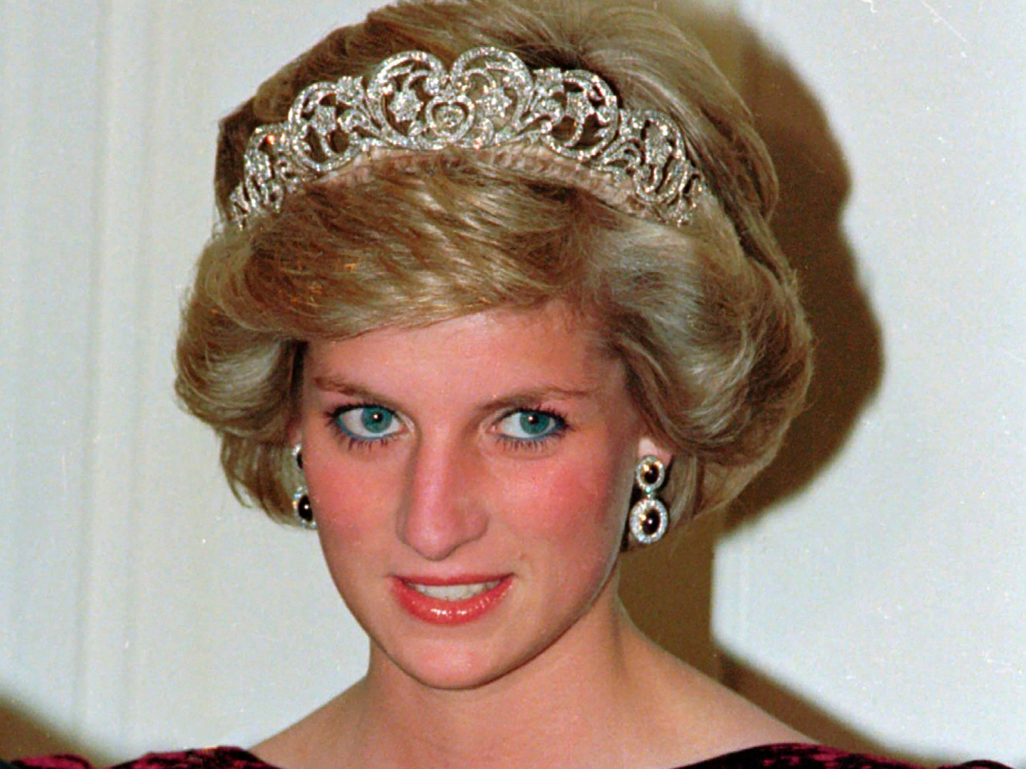
Princess Diana

Slide 7
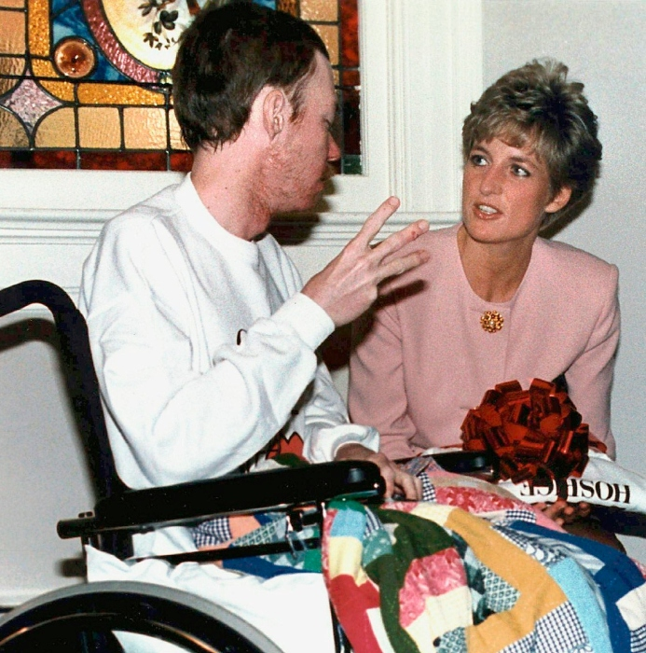
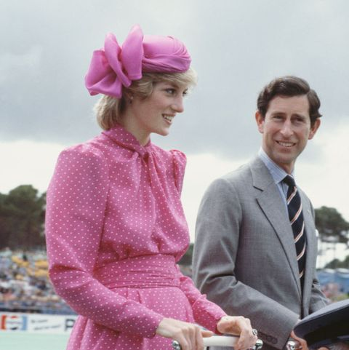

Slide 8
Being a member of the Royal Family => Taking much more responsibility

Slide 9
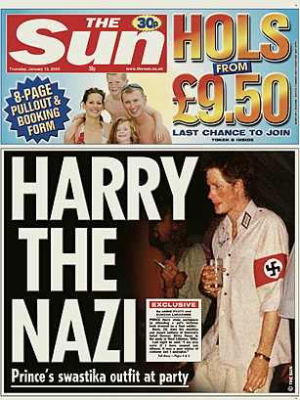
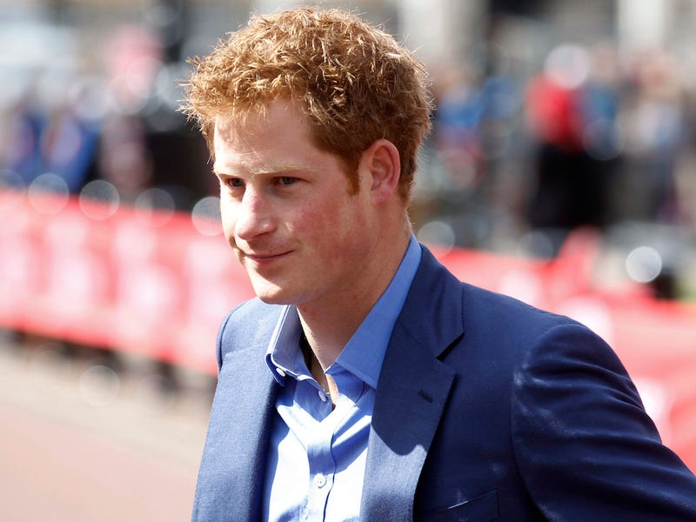
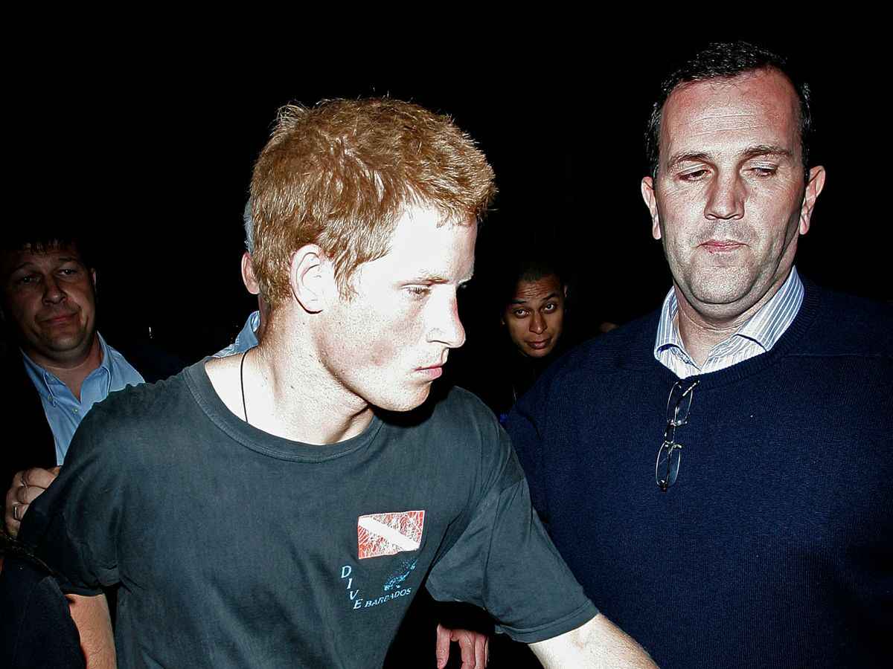

Slide 10
Conclusion

